Slide 1


Department of Computer Science and Engineering
Autism Spectrum Disorder Analysis and Detection System
Dr. Ananthajothi K M.E.,Ph.D.,
Professor
B21A2425C23
210701164 Mohanapriya E
210701169 Mukhilan S S

Slide 2
Problem Statement and Motivation
Early diagnosis of Autism Spectrum Disorder (ASD) is challenging due to reliance on subjective clinical observations and questionnaires. These methods are resource-intensive, leading to delayed interventions.
ASD affects communication , behavior and quality of life.
Early and accurate diagnosis improves developmental outcomes

Slide 3
Objectives
Develop a system for early ASD detection using machine learning algorithms.
Perform Exploratory Data Analysis (EDA) to understand dataset characteristics.
Use machine learning classifiers to improve detection accuracy. TabNet and other
Ensure scalability and accessibility of the diagnostic tool, including remote underserved regions.
Validate the system using performance metrics like accuracy, precision, recall, and F1 score.

Slide 4
Abstract
Autism Spectrum Disorder (ASD) is a neurodevelopmental disorder affecting social interaction and behavior.
The paper proposes a diagnostic system using machine learning (ML) models to overcome limitations of traditional methods.
TabNet was employed for clinical data analysis, supplemented by Random Forest, SVM, XGBoost, and other classifiers.
Preprocessing steps include imputation, feature scaling, and label encoding.
Results indicate high accuracy and reliability, paving the way for scalable diagnostic solutions.

Slide 5
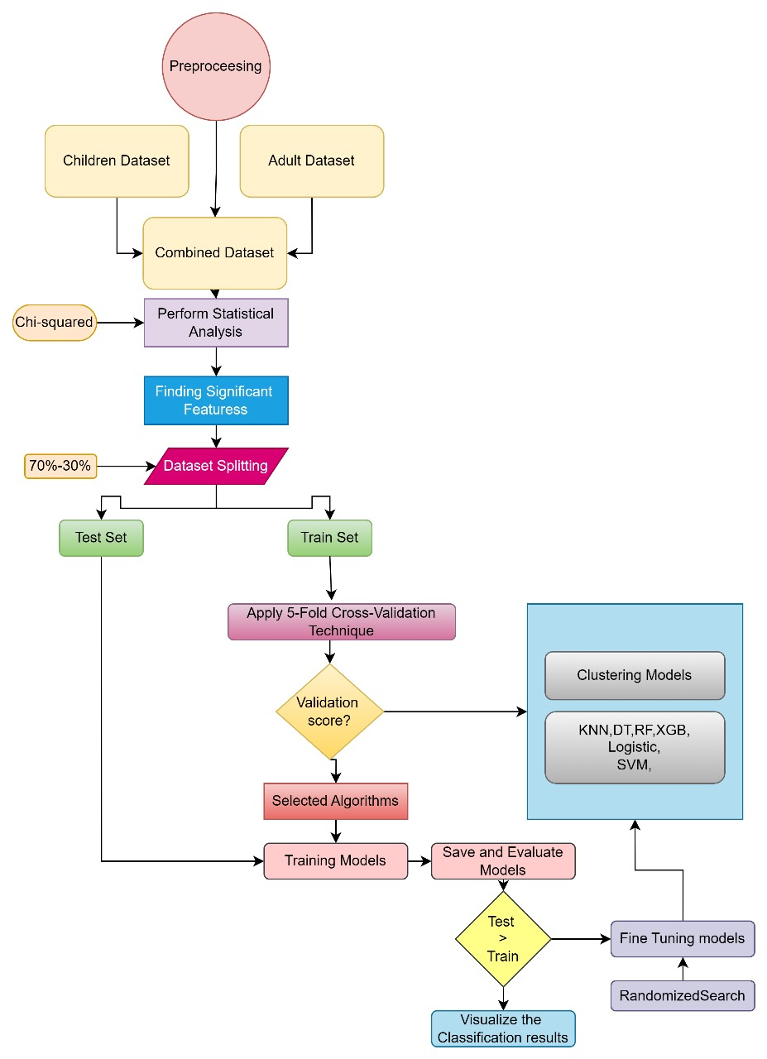
System Architecture

Slide 6
List of Modules
Slide 7: Functional Description for
Data Preprocessing
Exploratory Data Analysis (EDA):
Feature Selection:
Model Training:
Model Evaluation:
Deployment:

Slide 7
Functional Description for each modules with DFD and Activity Diagram
Data Preprocessing:
Activity Diagram: Show steps like handling missing data, encoding, and scaling.
DFD: Include a simple DFD showing data flow from raw data to preprocessed output.
Model Training:
Activity Diagram: Steps from splitting data to hyperparameter tuning and training.
DFD: Flow from preprocessed data to trained models.

Slide 8
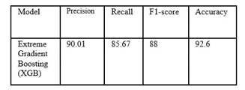
Implementation & Results of First Module
First Module: Data Preprocessing and Exploratory Data Analysis
Results:
Missing values handled using imputation.
Categorical variables encoded.
Heatmaps and count plots show distributions and correlations.
Insights gained about ASD-related patterns, such as Q-Chat-10 scores.

Slide 9
Conclusion & Work for Phase II
The diagnostic system demonstrates high accuracy using TabNet and other ML models.
Models like XGBoost and SVM showed robust performance with tuned hyperparameters.
The system provides insights into ASD patterns and facilitates early diagnosis.
Future Work:
Develop game-based cognitive assessment tools.
Explore Vision Transformers for analyzing MRI data.
Deploy the diagnostic system as a web or mobile application

Slide 10
References
[1] Ahmed, S. et al., "In-school and Community based Machine Learning oriented Psychological assessment of ASD.“
[2] Alteneiji, M.R. et al., "Diagnosis of Autism Spectrum Disorder Using Machine Learning Techniques.“
[3] Bala, M. et al., "Efficient machine learning models for early stage detection of ASD."

Slide 11
Paper Publication Status
PUBLICATION STATUS : Submitted for Approval
TITLE OF THE PAPER : Autism Spectrum Disorder Analysis And Detection System
AUTHORS : Ananthajothi K, Mohanapriya E, Mukhilan S S
NAME OF THE CONFERENCE : 6th International Conference on Mobile Computing and Sustainable Information(ICMCSI 2025)
MODE OF PUBLICATION: Online / Offline

Slide 12
Thank You

